Slide 1
Milestone 4
Justin Haysbert, Ryan Stevens, Shayne Shelton, Gabe Sagrera

Slide 2
Problem Statement
Electroencephalogram (EEG)
Interpret brain waves without movement by the person
Paralysis patients can use EEG to control items such as wheelchairs
EEG is noninvasive where others systems require surgical implants
Increases patient autonomy and accessibility
However, current issues with EEG…
Long training sessions
User-specific
Low signal to noise ratio

Slide 3
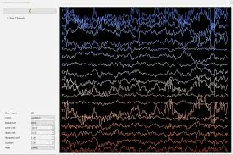
Problem Statement Cont…
Objectives
Streamlined User Experience
Rapid User Training
Application Linking
High Accuracy Classification
Quick System Response Time
Challenges
Low Signal to Noise Ratio
Need lots of examples for training

Slide 4
Proposed Solution
UI to guide user with example creation
EEG data collected live with feedback on misclassification
Will have user think of muscle movement at specified times
User controls a character on screen to help user adjust
Using LDA or Neural Network for classification
External computer running classification sent to arduino on wheelchair

Slide 5
Previous Works
https://www.youtube.com/watch?v=xStvKju-4-o&list=WL&index=2
Sentdex uses the openBCI headset to control a directional game
Gives us insight into data streaming
Shows an example of L/R only paradigm using CNN
https://docs.openbci.com/Examples/EEGProjects/MotorImagery/
This a thread detailing 2 movement classification using motor imagery
Showcases the use of Neuropype pipeline designer

Slide 6
Work Conducted
Developed GUI using Tkinter
Live streaming (View live data)
Recorded streaming (View recorded data)
User training (Our user training prompting scripts)
Model selection (sklearn, pytorch, tensorflow)
Model output (keyboard strokes based on predictions)
Used PyAutoGUI to use python to output keyboard controls
Can send the Left, Right, Up, and Down arrows keys to the system
Connected PyAutoGUI to Tkinter GUI
Created a temporary GUI section where you can click buttons to output the arrow keys

Slide 7
Work Conducted
Created data collection protocol
Step by step instructions for participants to use on collection days
Filed IRB
Filed initial IRB and now revising for human research approval
Researching data input methods
Open BCI stream eeg module via serial
Researching python modules that aid in BCI research
NeuroPype - platform with processing components for BCI
Allows for custom data filtering, real time data streaming and visualization
Pipeline design
Custom algorithmic design

Slide 8
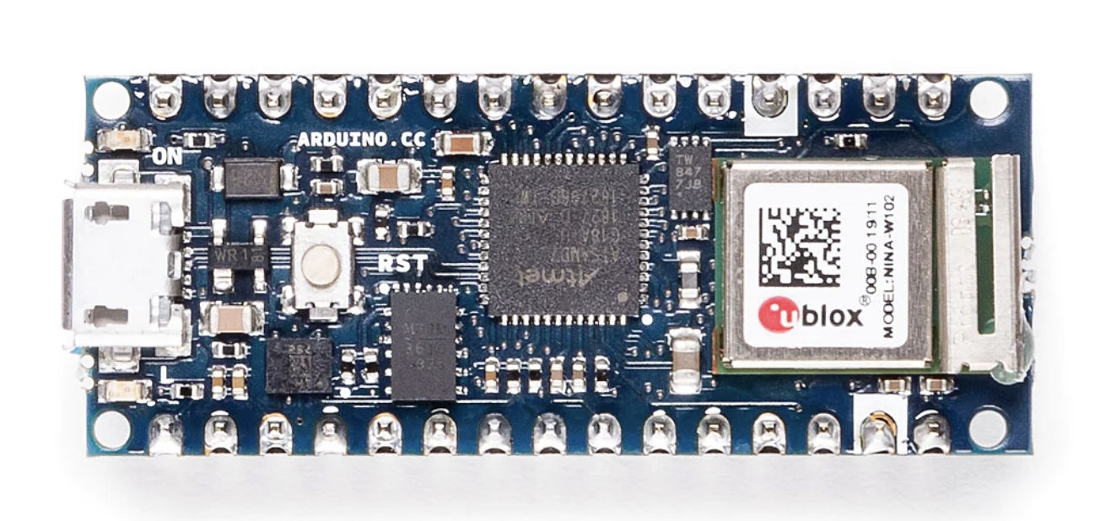
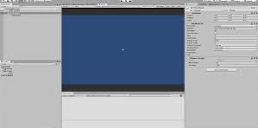
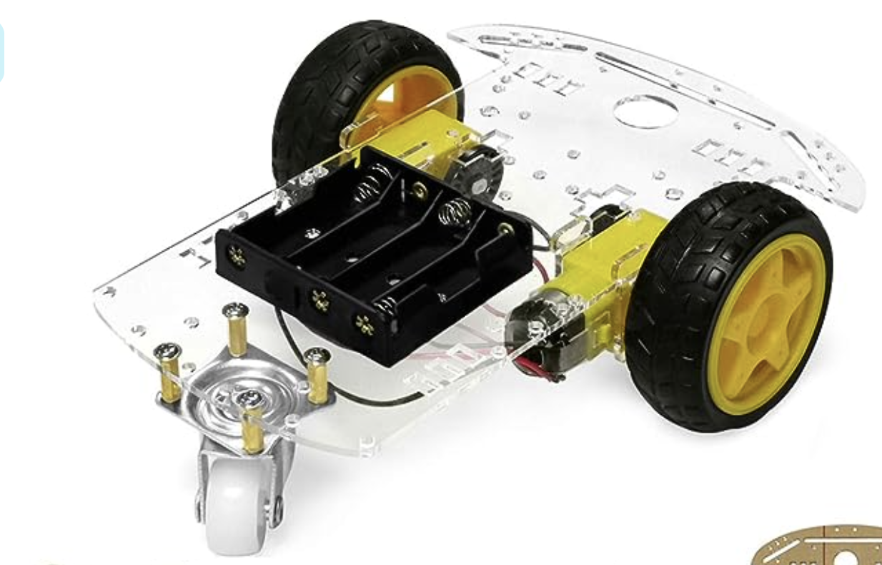
Work Conducted
Unity directional control game
Wheelchair prototype

Slide 9
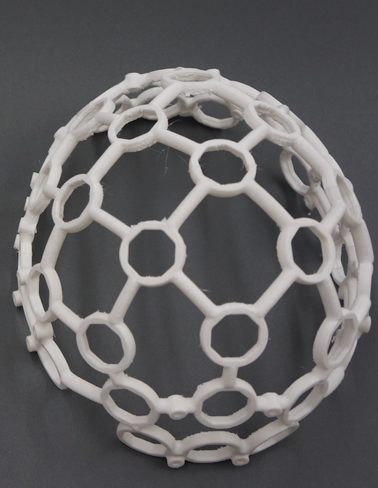
Work Conducted
Completed printing of EEG headset frame
Frame is glued with screw inserts and ready for electrode
Researched Gathertown for UI integration

Slide 10
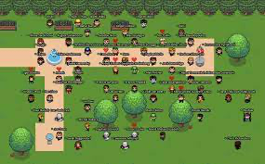
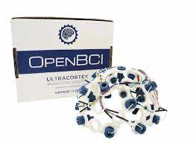
Challenges
Sending keys from our GUI to the web app / Gather Town application is challenging
Reading the headset data serial (if possible) or over local network
Unsure of how much latency the network option adds
Still waiting to receive Open BCI eeg headset parts

Slide 11
Next Steps
Decide between Gather Town or simple control game
Connect GUI outputs to game choice inputs
Once received, integrate headset with the GUI
Create the user training procedure

Slide 12
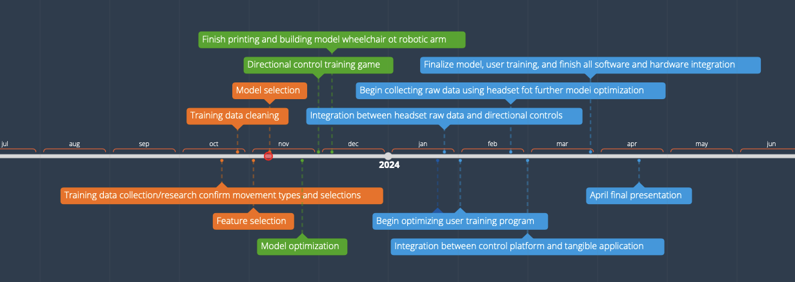
Timeline

Slide 13
Thanks!!

